Slide 1

ROLE OF SURVEY SAMPLING IN DATA COLLECTION
By
Prof. G. N. Singh
Professor & HOD
Department of Mathematics & Computing
Indian Institute of Technology (Indian School of Mines), Dhanbad.
Role of Survey Sampling in Data Collection by Prof. G. N. Singh
9/21/2020

Slide 2
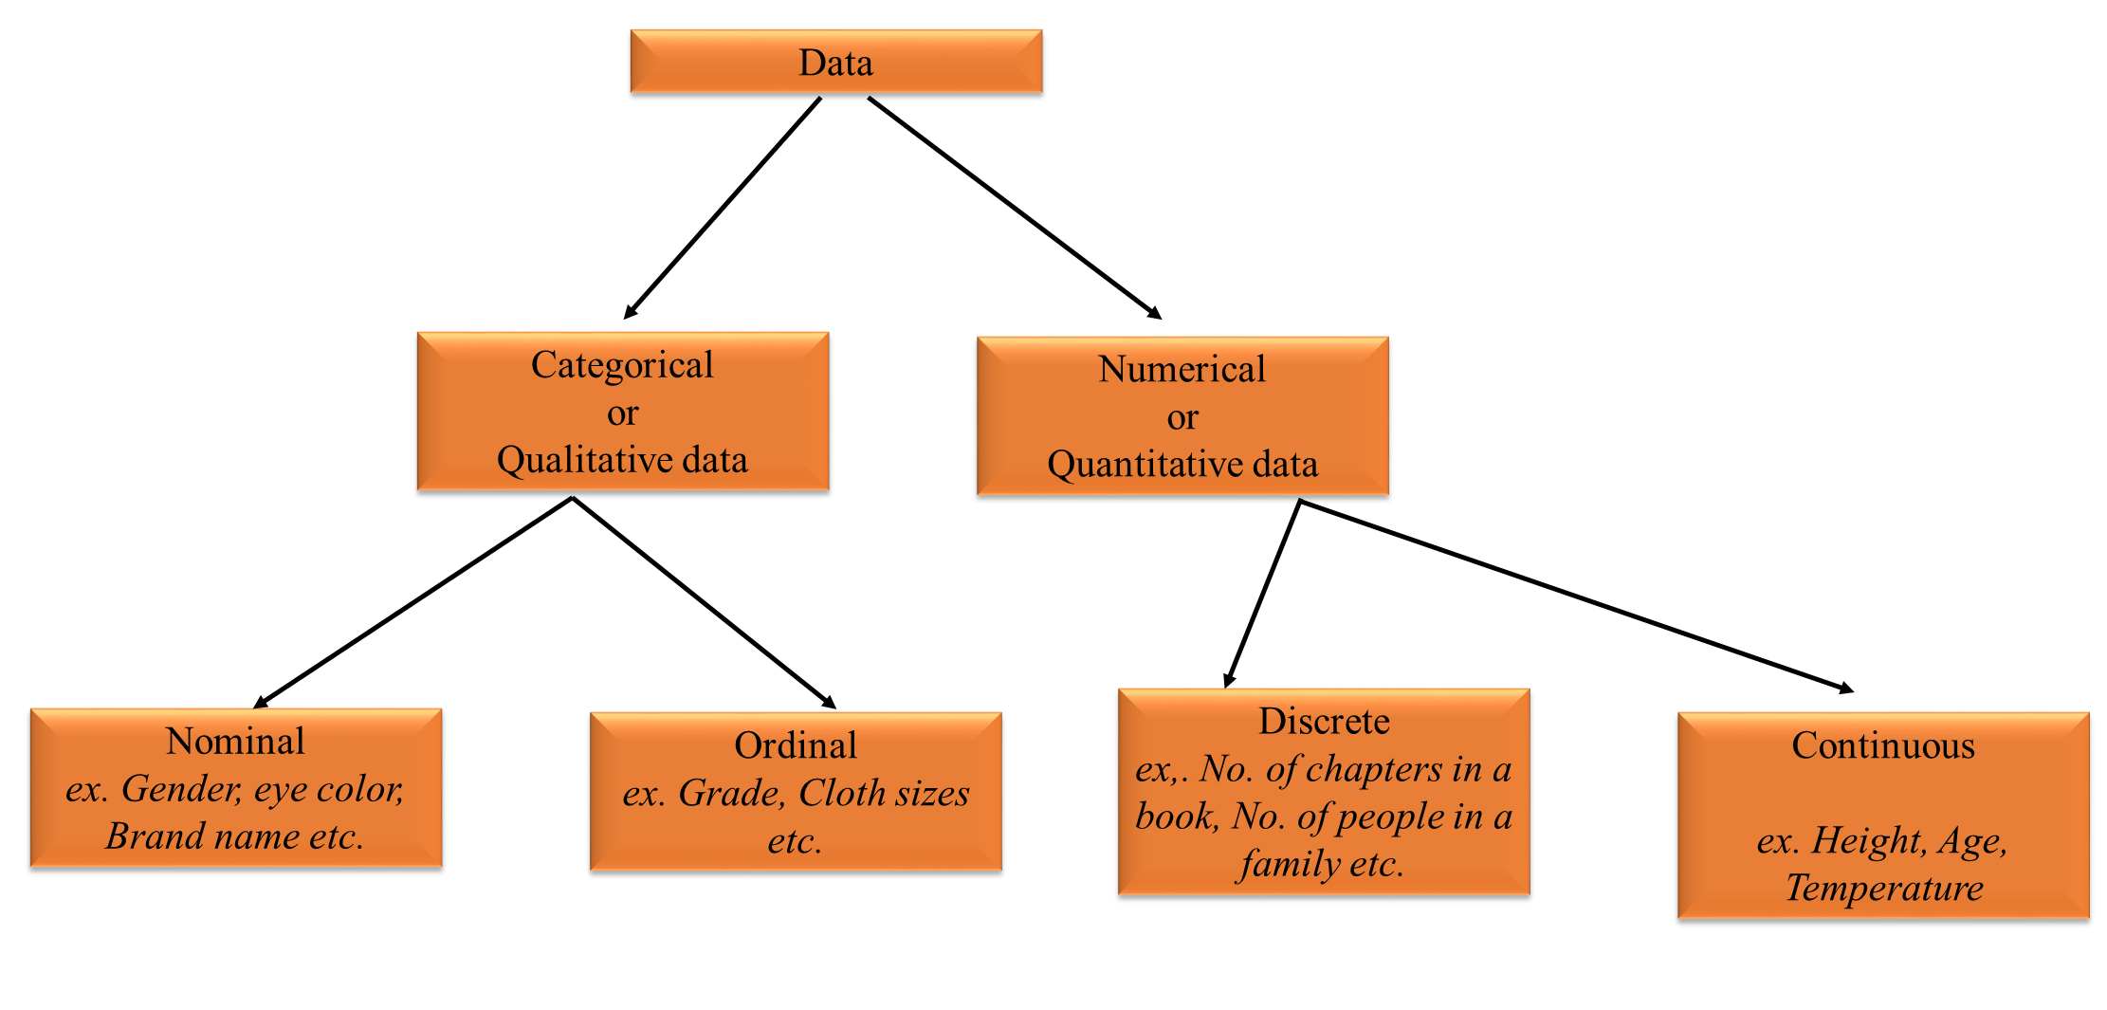
Overview of Statistics
Data: Data are individual pieces of factual information recorded and used for the purpose of analysis. It is also a numerical representation of fact.
Role of Survey Sampling in Data Collection by Prof. G. N. Singh
9/21/2020

Slide 3

Characteristics of Data
Central tendency
Dispersion
Skewness
Kurtosis
Collection of Data
Census or Complete Count
Survey Sampling
Role of Survey Sampling in Data Collection by Prof. G. N. Singh
9/21/2020

Slide 4
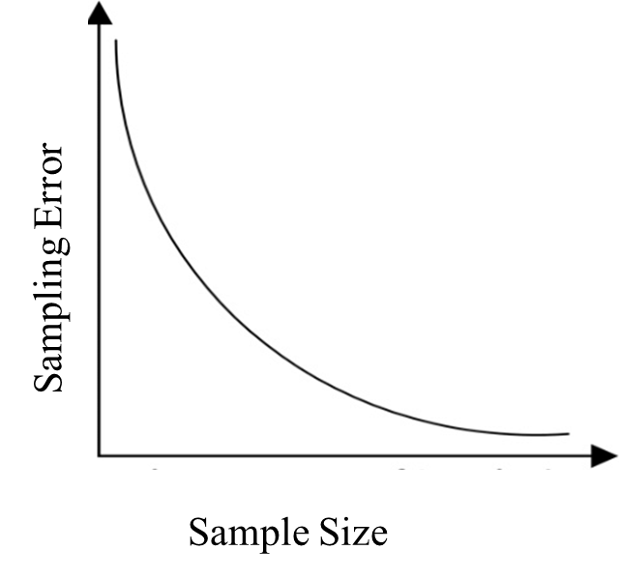
Errors in Data Collection
Sampling Error
Non-Sampling Error
Sampling Error
If the sample is not the true representative of the whole population.
Role of Survey Sampling in Data Collection by Prof. G. N. Singh
9/21/2020

Slide 5
ii. Non-Sampling Error
The main sources of Non-Sampling errors are:
Failure to measure some of the units in the selected sample may be due to non-response.
Observational error due to defective measurement technique.
Errors introduced in editing, coding and tabulation the results
Role of Survey Sampling in Data Collection by Prof. G. N. Singh
9/21/2020

Slide 6

Census or Complete Count
The total count of all units of the population for a certain characteristic or for many characters is known as Complete enumeration, also termed as Census Survey.
Huge amount of cost, man power and time required.
Some times the complete enumeration is not possible when the units are perishable in nature. For example- Bullet testing.
Role of Survey Sampling in Data Collection by Prof. G. N. Singh
9/21/2020

Slide 7
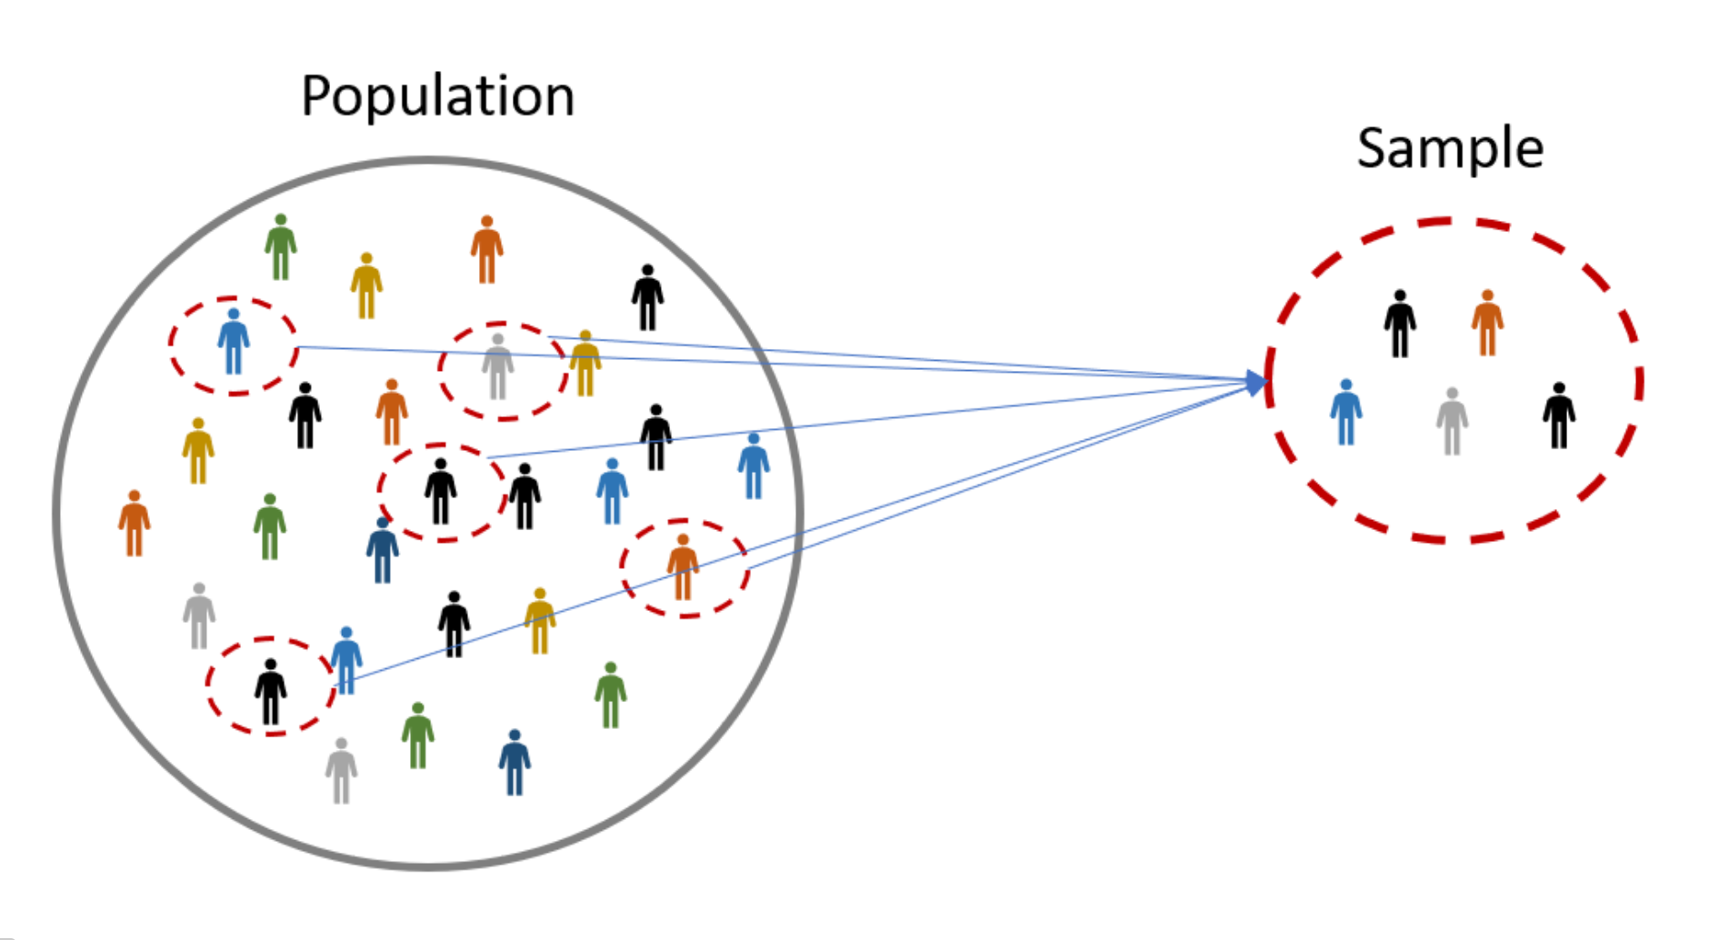
Sample
It is a unit that is selected from population.
Representative the whole population.
Purpose to draw the inference.
Sampling Frame
List of population units for identification.
Role of Survey Sampling in Data Collection by Prof. G. N. Singh
9/21/2020

Slide 8
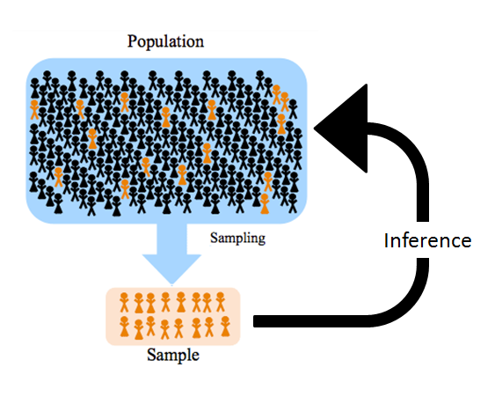
Sampling
Sampling is the process of selecting desired number of units from a population (a sample) to provide an adequate description and inferences of the population or equivalently about the population parameters.
Role of Survey Sampling in Data Collection by Prof. G. N. Singh
9/21/2020

Slide 9
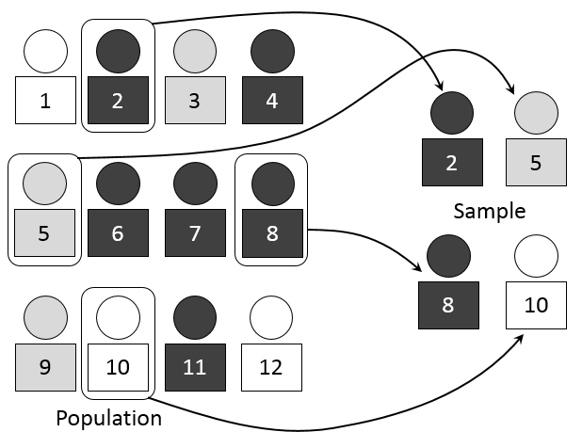
Need of Sampling
Complete enumeration may not be possible.
Resources: lower cost lesser resources required.
Speed: Faster results due to lesser coverage.
Reliable information
To draw conclusions about population from sample, there are two major requirements for a sample
Sample size should be large subject to the availability to the resources.
Sample has to be selected appropriately so that it is representative of the population. Sample should have all the characteristics of the population.
Role of Survey Sampling in Data Collection by Prof. G. N. Singh
9/21/2020

Slide 10
Advantage and Disadvantage of Sampling
Advantages
Disadvantages
Saves time and labor.
Results in reduction of cost in terms of money and time.
Ends up with greater accuracy of results
Has greater scope.
Has greater adaptability.
If the population is too large, or hypothetical sampling is the only method to be used.
There is always a sampling error.
Sampling may create a feeling of discrimination within the population.
Sampling may be inadvisable where every unit in the population is legally required to have a record.
For rare events, small samples may not yield sufficient cases for study.
Sample may be biased if hidden periodicity in population coincides with that of selection.
Role of Survey Sampling in Data Collection by Prof. G. N. Singh
9/21/2020

Slide 11
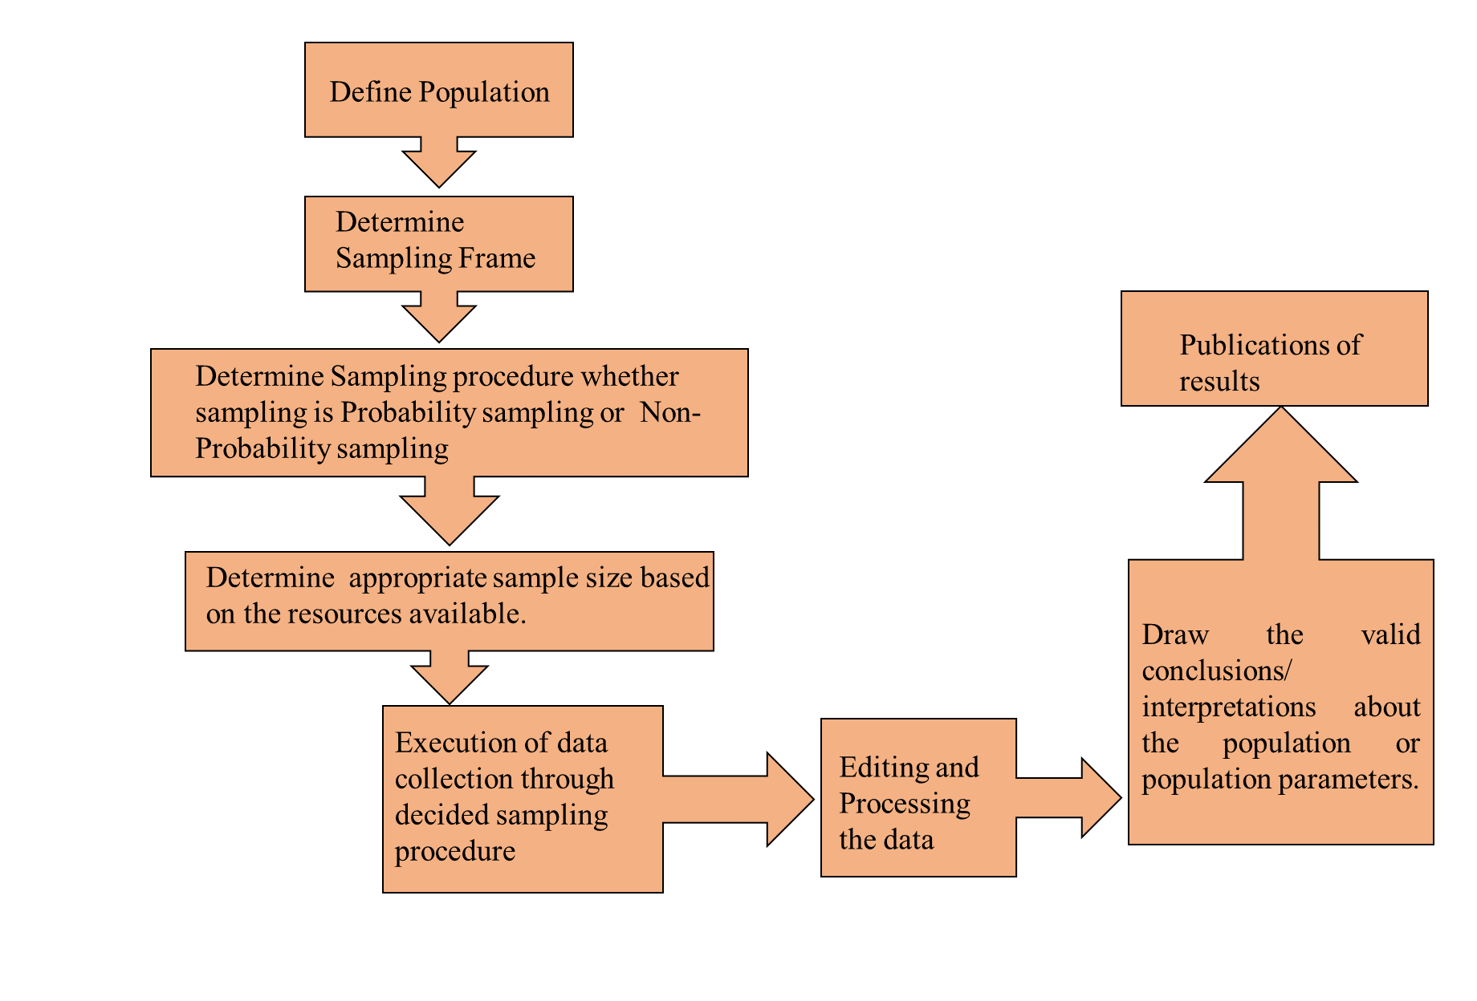
Steps of Conducting a Sample Survey
Role of Survey Sampling in Data Collection by Prof. G. N. Singh
9/21/2020

Slide 12
Principles of Sampling
The theory of sampling is based on three important basic principles:
Principle of Statistical Regularity
A moderately large number of items chosen at random from a large group are almost sure on the average to process the characteristics of the large group.
Principle of Validity
The sampling design provides valid estimates about population parameters which means sample should be selected in such a way so that estimates can be explained in terms of probability.
Principle of Optimization
Given level of efficiency at minimum cost.
Maximum possible efficiency with given cost.
Role of Survey Sampling in Data Collection by Prof. G. N. Singh
9/21/2020

Slide 13
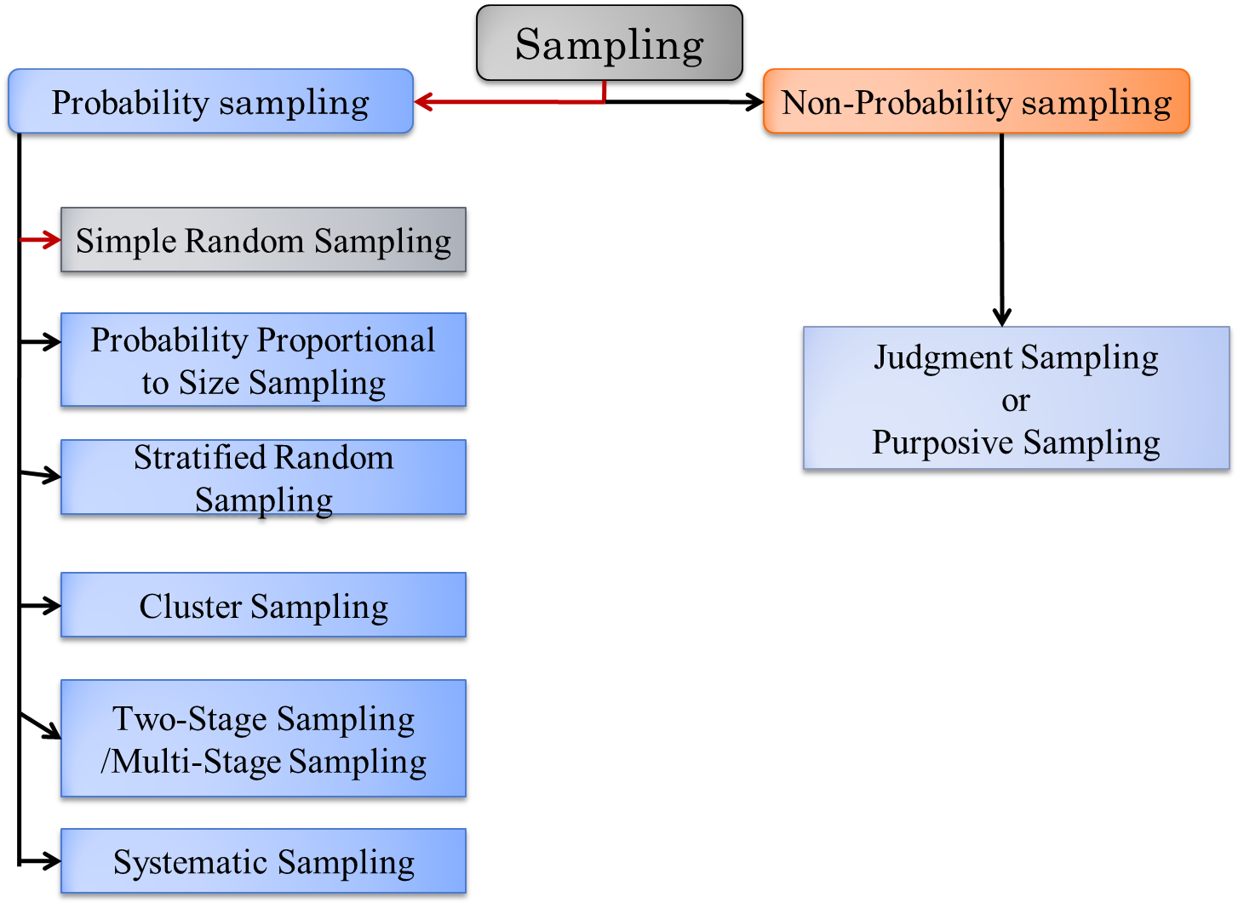
Types of Survey Sampling
Role of Survey Sampling in Data Collection by Prof. G. N. Singh
9/21/2020

Slide 14

Judgmental Sampling
It is also known as purposive sampling.
Respondents are selected according to an experienced researcher’s belief that they will meet the requirements of the study.
Role of Survey Sampling in Data Collection by Prof. G. N. Singh
9/21/2020

Slide 15
Advantage and Disadvantage of Judgmental Sampling
Advantage
Disadvantage
Low cost.
Less time involved.
A select number of people who are known to be related to the topic are part of the study which means that there are lesser chances of having people who will distort the data.
Meet the specific objective.
Mostly used in demographic surveys.
It can be subject to researcher’s bias.
The group selected may not be represent all the population.
Role of Survey Sampling in Data Collection by Prof. G. N. Singh
9/21/2020

Slide 16
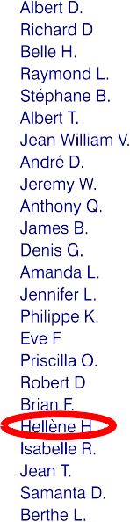
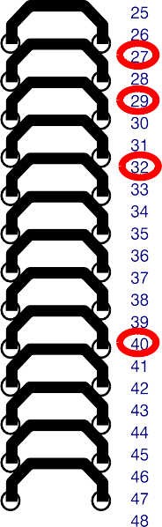
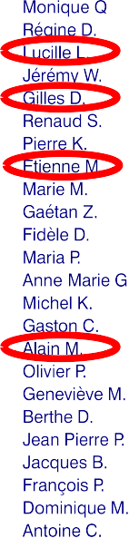
Simple Random Sampling
Simplest and most common method.
Also known as Unrestricted random sampling.
Each unit of the population has equal chance of selection.
Role of Survey Sampling in Data Collection by Prof. G. N. Singh
9/21/2020

Slide 17
Advantage and Disadvantage of Simple Random Sampling
Advantage
Disadvantage
Minimal knowledge of population needed.
Easy to analyze data.
High probability of representative sample.
Meets assumptions of many statistical procedures.
Low frequency of use.
Does not use researchers’ expertise.
Larger risk of sampling error.
Role of Survey Sampling in Data Collection by Prof. G. N. Singh
9/21/2020

Slide 18


Probability Proportional to Size Sampling
This type of sampling procedure where the probability of sample is proportional to the size of the unit.
Probability of drawing any specified unit differs from draw to draw.
Role of Survey Sampling in Data Collection by Prof. G. N. Singh
9/21/2020

Slide 19
Advantage and Disadvantage of PPS Sampling
Advantage
Disadvantage
Expanding a PPS sample is difficult.
Provide a conservative (higher) estimate of misstatement.
Results in smaller sample sizes.
Effective for overstatement errors.
Generally simpler to use than classical variable sampling.
SRS is a particular case of this sampling.
Role of Survey Sampling in Data Collection by Prof. G. N. Singh
9/21/2020

Slide 20
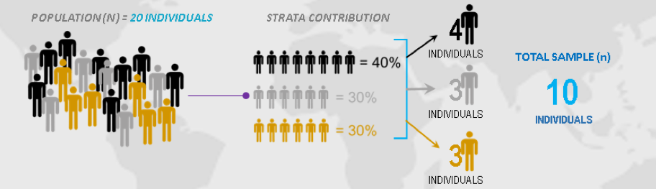
Stratified Random Sampling
Population is divided into the homogeneous groups (with respect to study character) called Strata.
Samples are randomly selected independently from each strata.
Role of Survey Sampling in Data Collection by Prof. G. N. Singh
9/21/2020

Slide 21
Advantage and Disadvantage of Stratified Random Sampling
Advantage
Disadvantage
Minimizing sample selection bias.
Less variability.
Cost reduced if strata already exists.
It can be used for both proportional and non-proportional samples.
Stratification brings a gain in the precision in estimation of a characteristic of a population.
It is unusable when researchers cannot confidently classify every member of the population into a subgroup
The sorting process becomes more difficult, rendering stratified random sampling an ineffective and less than ideal method
High cost
Role of Survey Sampling in Data Collection by Prof. G. N. Singh
9/21/2020

Slide 22
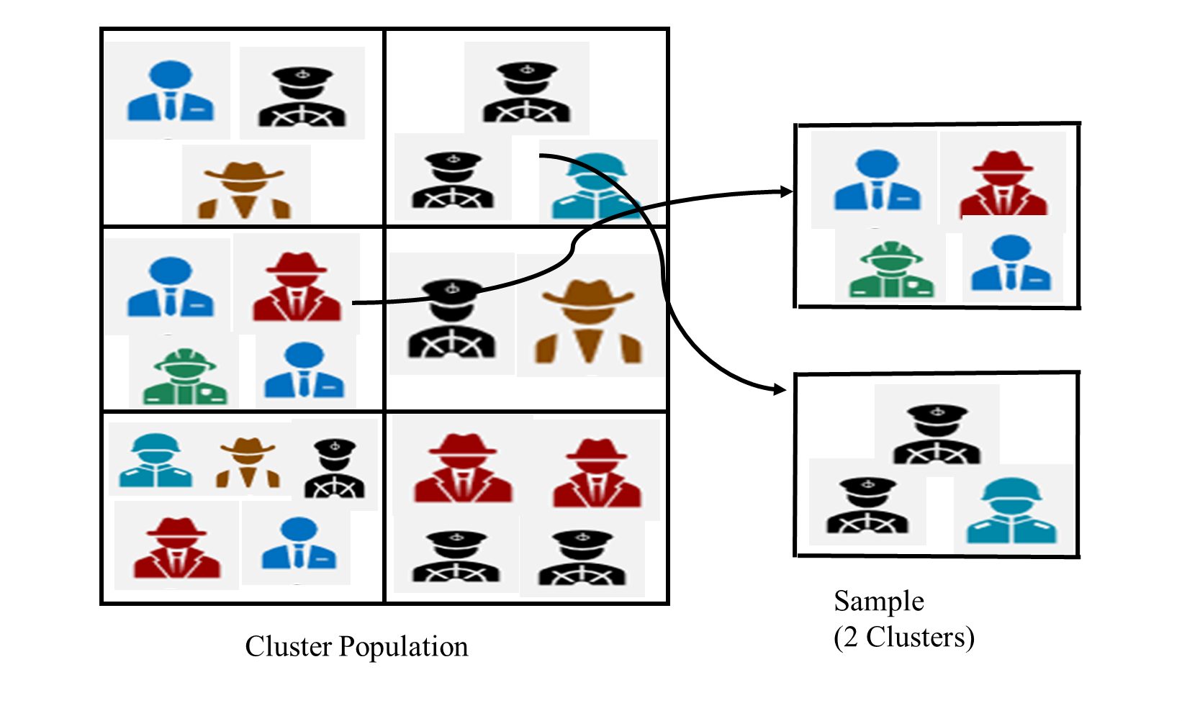
Cluster Random Sampling
The population is divided into subgroups (clusters) according to some well defined rule. (for ex. Families).
Choose a sample of clusters according to some procedure.
Carry out a complete enumeration of the selected clusters
Role of Survey Sampling in Data Collection by Prof. G. N. Singh
9/21/2020

Slide 23
Advantage and Disadvantage of Cluster Random Sampling
Advantage
Disadvantage
Very useful when populations are large and spread over a large geographical region.
Simple as complete list of sampling units within population not required.
Less travel / resources required.
Economically efficient.
Cluster may not be representative of
whole population but may be too alike.
Statistically less efficient i.e. standard
error of the estimate is likely to be large.
Role of Survey Sampling in Data Collection by Prof. G. N. Singh
9/21/2020

Slide 24
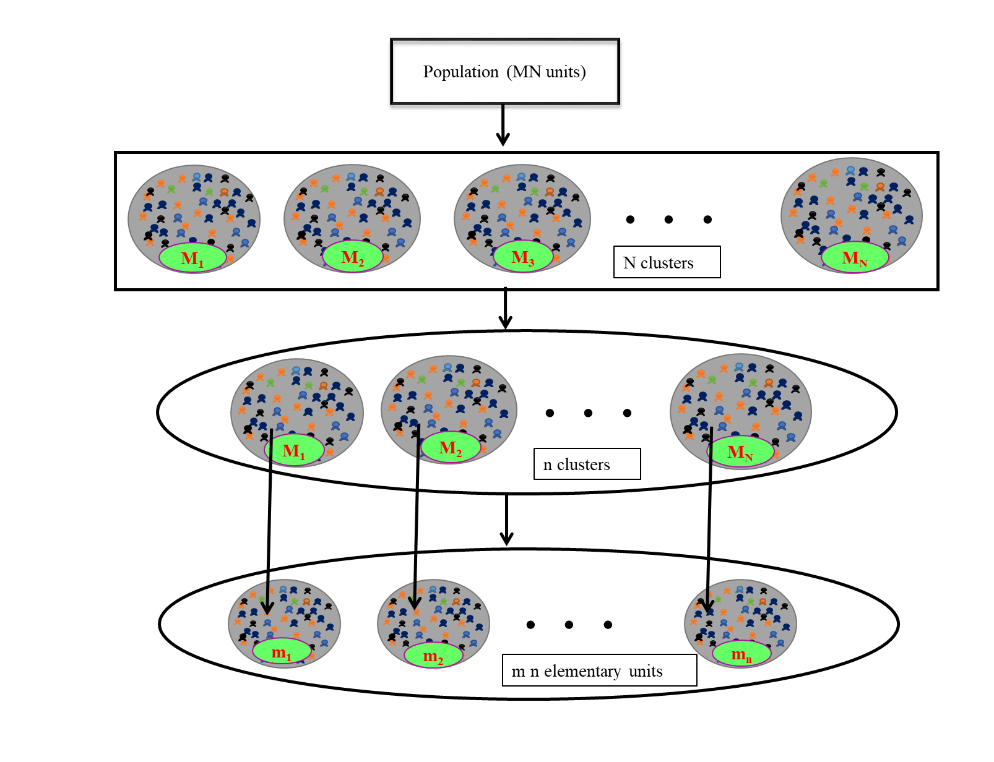
Two-Stage Sampling
In this sampling first select the clusters.
Selecting a specified number of elements from each selected cluster.
Role of Survey Sampling in Data Collection by Prof. G. N. Singh
9/21/2020

Slide 25
Advantage and Disadvantage of Two-Stage Sampling
Advantage
Disadvantage
More Accurate.
More Effective.
Most feasible approach for large
population.
Each stage in sampling introduces sampling error-the more stages there are, the more error there tends to be.
Needs more man power.
Role of Survey Sampling in Data Collection by Prof. G. N. Singh
9/21/2020

Slide 26
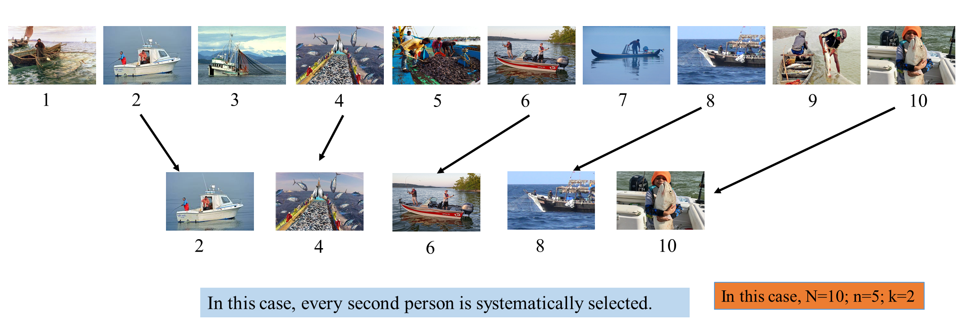
Systematic Random Sampling
First unit is selected with the help of random numbers.
Rest get selected automatically according to some pre-assigned pattern .
Found very useful in forest surveys for estimating the volume of timber, in fisheries for estimating the total catch of fish etc.
N=n*k, where k is an integer.
Role of Survey Sampling in Data Collection by Prof. G. N. Singh
9/21/2020

Slide 27
Advantage and Disadvantage of Systematic Random Sampling
Advantage
Disadvantage
Moderate cost; moderate usage.
Simple to draw sample.
Easy to verify.
Periodic ordering required.
Sample sizes may vary.
Not possible to estimate the population variance.
Role of Survey Sampling in Data Collection by Prof. G. N. Singh
9/21/2020

Slide 28

Methods of Estimation
About Auxiliary Information
Auxiliary information means additional information about the character under study.
It is easily available for each unit of the population
For ex: Number of doctors, beds, supporting staff & patients which is known can be used as auxiliary information on hospital survey.
Role of Survey Sampling in Data Collection by Prof. G. N. Singh
9/21/2020

Slide 29
Methods of Estimation with and without Auxiliary Information
Without using Auxiliary Information.
- For ex. Sample mean
By using Auxiliary Information.
- For ex. (i). Ratio estimator
(ii). Product estimator
(iii). Regression estimator
Role of Survey Sampling in Data Collection by Prof. G. N. Singh
9/21/2020

Slide 30
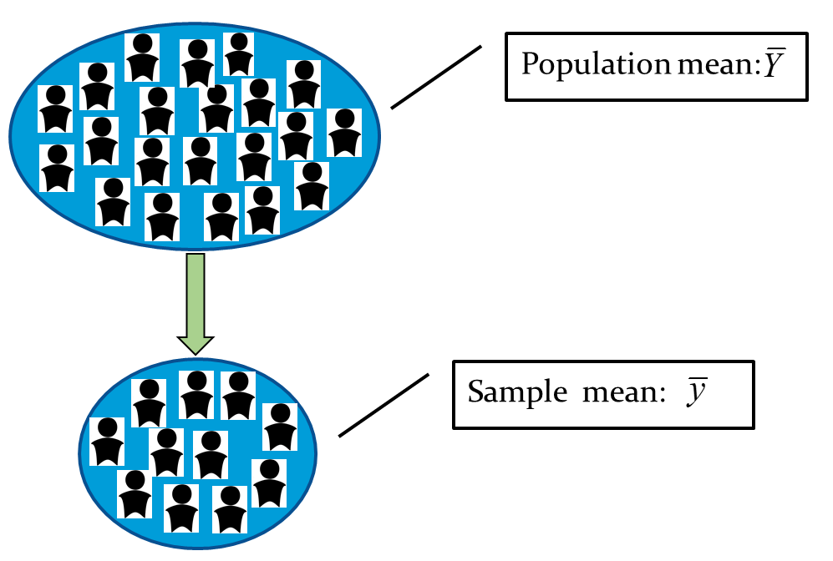
Sample mean
Let denote the sample value of the unit selected in the sample, then the sample mean is defined as:
Role of Survey Sampling in Data Collection by Prof. G. N. Singh
9/21/2020

Slide 31

Ratio estimator
Cochran (1940) was the first to show the contribution of known auxiliary information in improving the efficiency of the estimator population mean in survey sampling.
Role of Survey Sampling in Data Collection by Prof. G. N. Singh
9/21/2020

Slide 32
Product estimator
Murthy (1964) considered another estimator of population mean using known population mean of auxiliary variable as a Product estimator
Role of Survey Sampling in Data Collection by Prof. G. N. Singh
9/21/2020

Slide 33
Regression estimator
Hansen, Hurwitz and Madow (1953) consider the linear difference/ regression estimator of the population mean as:
Role of Survey Sampling in Data Collection by Prof. G. N. Singh
9/21/2020

Slide 34
Know more about Ratio, Product and Regression estimators
Ratio Estimator | Product Estimator | Regression Estimator
The correlation between y and x must be positive and high (within +0.5 and +1.0) | The correlation between y and x must be negative and high (within -1.0 and -0.5) | The correlation between y and x must be non-zero within the range [-1.0 and +1.0].
Role of Survey Sampling in Data Collection by Prof. G. N. Singh
9/21/2020

Slide 35
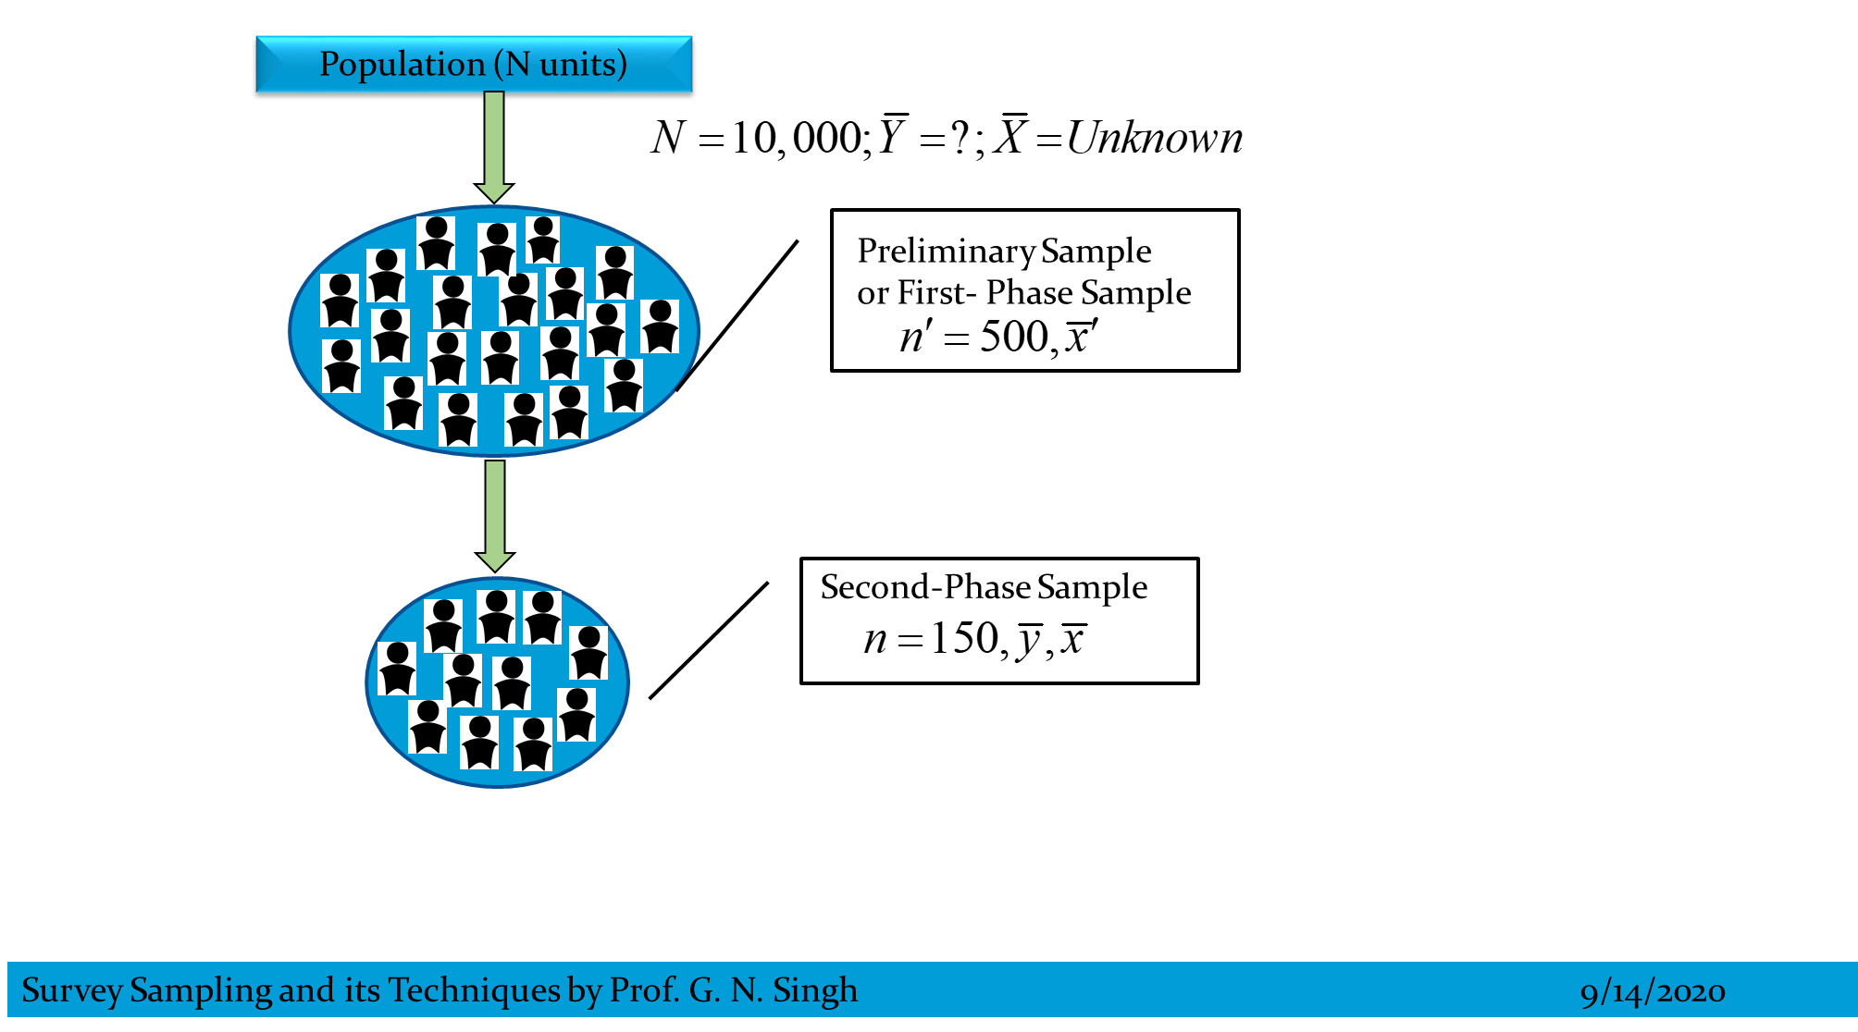
Two-Phase Sampling
Also known as Double Sampling.
The randomization is done twice.
First a random sample is drawn from the population.
Then again a random second phase sample is drawn from the first sample.
Role of Survey Sampling in Data Collection by Prof. G. N. Singh
9/21/2020

Slide 36
Advantage and Disadvantage of Two-Phase Sampling
Advantage
Disadvantage
Offers more detailed information on the topic of the study.
Cost effective.
Necessary to have a complete sampling frame of units.
Role of Survey Sampling in Data Collection by Prof. G. N. Singh
9/21/2020

Slide 37
The Two-Phase Ratio, Product and Regression Estimators
Ratio estimator
Product estimator
Regression estimator
Role of Survey Sampling in Data Collection by Prof. G. N. Singh
9/21/2020

Slide 38
T
H
A
N
K
Y
O
U
Survey Sampling and its Techniques by Prof. G. N. Singh
9/21/2020

